Slide 1
VERY ROUGH CRASH-Course in HMMs
Bioinformatics & Computational Biology
Larry Davis, Shane Dooley, Zach Lozier, Colleen Yanarella

Slide 2
Outline
Hidden Markov Model Background
Biology Applications
HMM Probabilities
Forward Algorithm
Questions

Slide 3
Hidden Markov Model (HMM) Background
HMM are a type of Bayesian Network (BN)
BN use Bayesian Inference
BN can be represented as Directed Acyclic Graphs (DAG)
HMM Builds on the concept of Markov Chains (MC)
Probabilities of a sequence of random variables, called states
Utilizes the Markov Assumption
Image from: https://www.researchgate.net/figure/Bayesian-Network-for-Wetgrass-Example_fig1_220986239

Slide 4
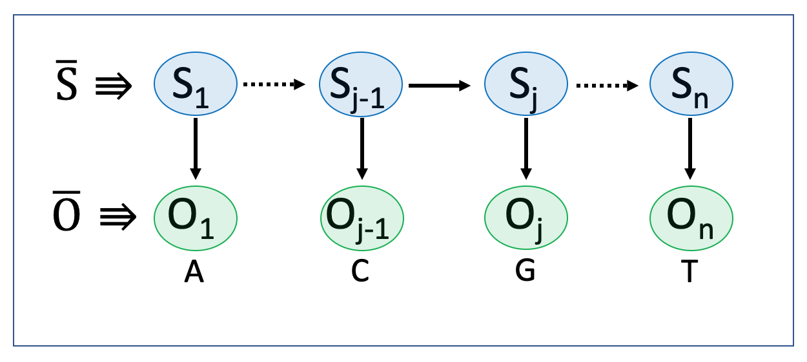
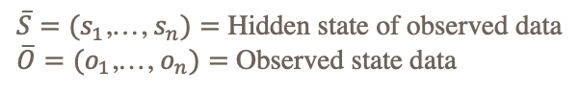
What are HMMs?
HMMs have observable sequence(s) of data and hidden data
An observation results from a state step that can take on any value of the state space
HMMs are used to calculate the likelihood of observing a sequence
$\overline{S}=(s_{1}$,…, $s_{n})=$ Hidden state of observed data
$\overline{O}=(o_{1}$,…, $o_{n})=$ Observed state data

Slide 5
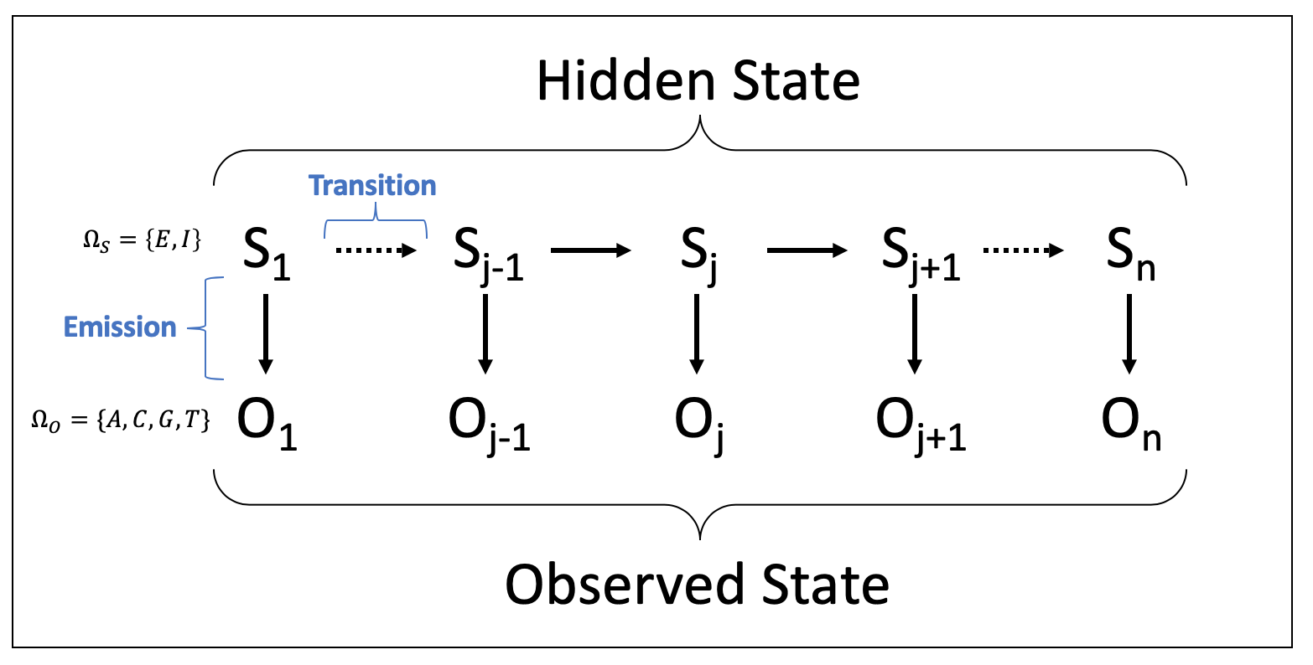
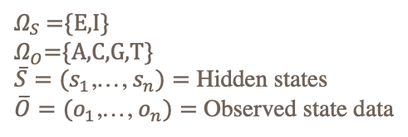
HMM Parameters
Transition Probabilities: $τ=$ $\operatorname{Pr}\left(S_{j} | S_{j−1}\right)$ for $j≥2$
Emission Probabilities: $ε= Pr\left(O_{j} | S_{j}\right)$ for $j ≥1$
Initial State Distribution: $π= \operatorname{Pr}\left(S_{1}\right)$
$Ω_{S}$ ={E,I}
$Ω_{O}$={A,C,G,T}
$\overline{S}=(s_{1}$,…, $s_{n})=$ Hidden states
$\overline{O}=(o_{1}$,…, $o_{n})=$ Observed state data

Slide 6
HMM Applications in Biology
DNA
Hidden States:
CpG island
Genic / intergenic
Exon/intron
Motif
Promoter, 5’/3’ UTR, … other annotations
Consensus
Evolution
Insertion/deletion/substitution (MSA)
Common ancestor
Genetic linkage (more exact LOD scores)

Slide 7
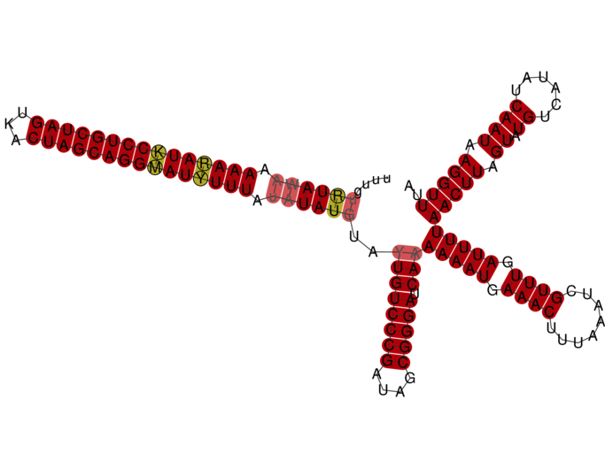
RNA

Slide 8
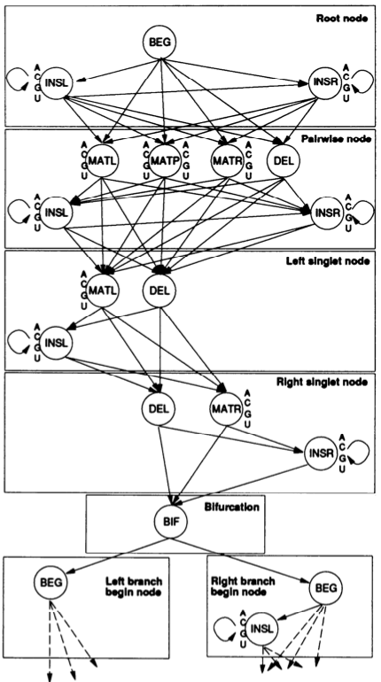
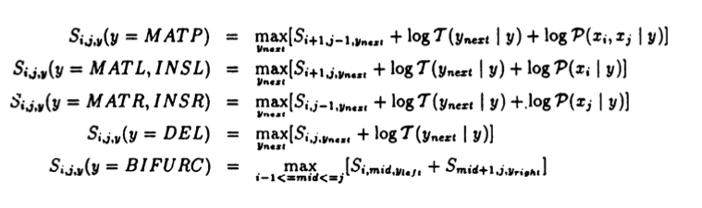
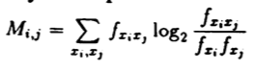
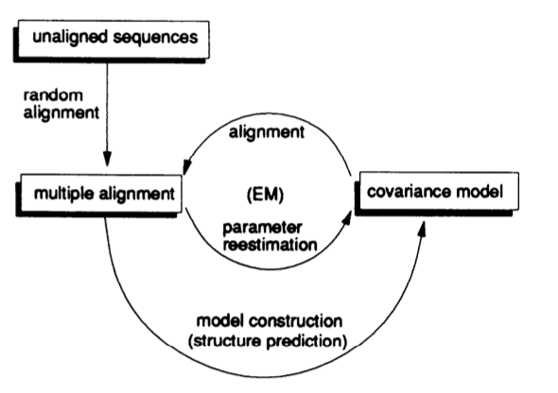
Notes:
Add reference

Slide 9
Gene Anatomy
Notes:
Image from: https://www.britannica.com/science/gene/media/228226/114928
Genes are discontinuous the portions that contribute to the end product (coding regions) are called exons, regions that are not are called introns

Slide 10
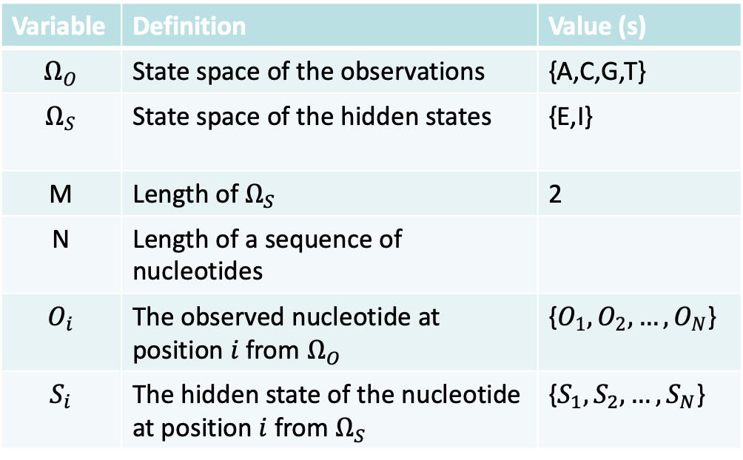
Intron, Exon HMM Probability
Variable | Definition | Value (s)
$$Ω_{O}$$ | State space of the observations | {A,C,G,T}
$$Ω_{S}$$ | State space of the hidden states | {E,I}
M | Length of $Ω_{S}$ | 2
N | Length of a sequence of nucleotides
$$O_{i}$$ | The observed nucleotide at position $i$ from $Ω_{O}$ | {$O_{1},O_{2},…, O_{N}$}
$$S_{i}$$ | The hidden state of the nucleotide at position $i$ from $Ω_{S}$ | {$S_{1},S_{2},…, S_{N}$}
Notes:
We don’t know these things, but luckily, we have learned about Expectation Maximization so we can solve that using a special case of an EM called the Baum-Welch algorithm and then

Slide 11
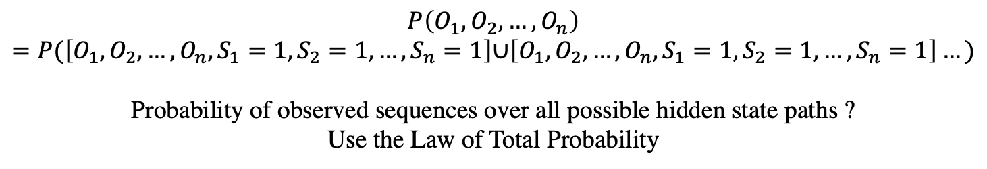
$$P\left(O_{1},O_{2},…,O_{n}\right)=P(\left[O_{1},O_{2},…,O_{n},S_{1}=1, S_{2}=1,…,S_{n}=1\right]\text{∪}\left[O_{1},O_{2},…,O_{n},S_{1}=1, S_{2}=1,…,S_{n}=1\right]…)$$
Probability of observed sequences over all possible hidden state paths ?
Use the Law of Total Probability

Slide 12
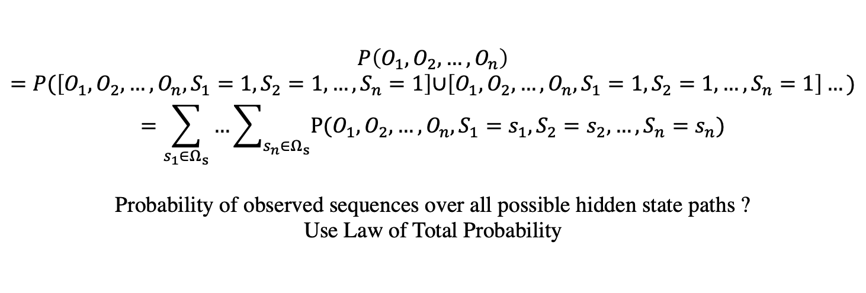
$$P\left(O_{1},O_{2},…,O_{n}\right)=P(\left[O_{1},O_{2},…,O_{n},S_{1}=1, S_{2}=1,…,S_{n}=1\right]\text{∪}\left[O_{1},O_{2},…,O_{n},S_{1}=1, S_{2}=1,…,S_{n}=1\right]…)$$
$$=\sum_{s_{1}∈Ω_{s}}{…\sum_{s_{n}∈Ω_{s}}{P(O_{1},O_{2},…,O_{n},S_{1}=s_{1}, S_{2}=s_{2},…,S_{n}=s_{n})}}$$
Probability of observed sequences over all possible hidden state paths ?
Use Law of Total Probability

Slide 13
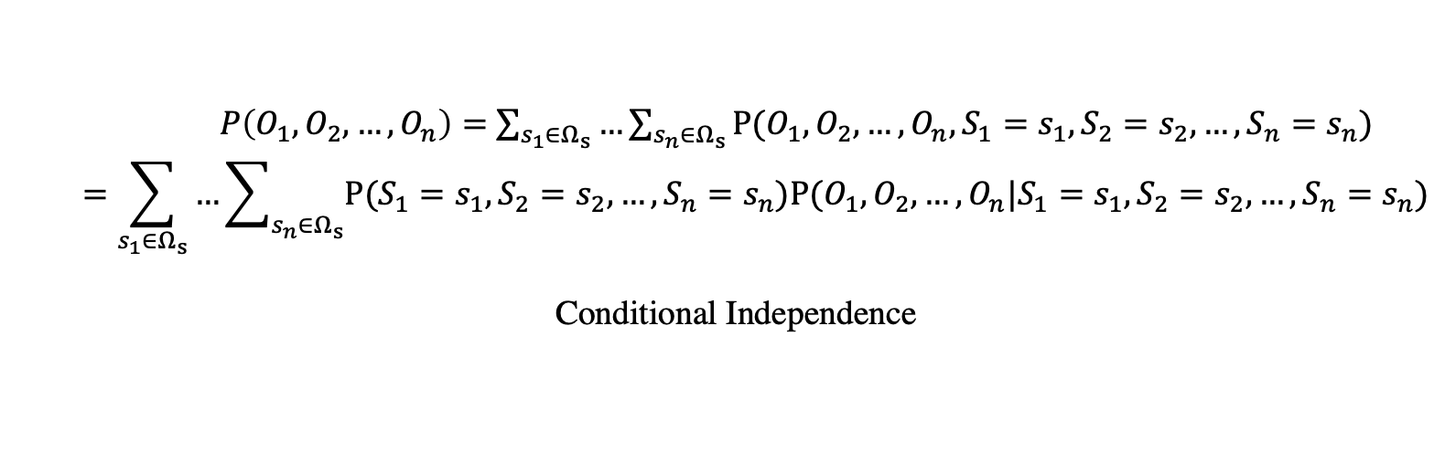
$P\left(O_{1},O_{2},…,O_{n}\right)=$ $\sum_{s_{1}∈Ω_{s}}{…\sum_{s_{n}∈Ω_{s}}{P(O_{1},O_{2},…,O_{n},S_{1}=s_{1}, S_{2}=s_{2},…,S_{n}=s_{n})}}$
$$=\sum_{s_{1}∈Ω_{s}}{…\sum_{s_{n}∈Ω_{s}}{P(S_{1}=s_{1}, S_{2}=s_{2},…,S_{n}=s_{n})P(O_{1},O_{2},…,O_{n}|S_{1}=s_{1}, S_{2}=s_{2},…,S_{n}=s_{n})}}$$
Conditional Independence
Notes:
change to conditional probability

Slide 14
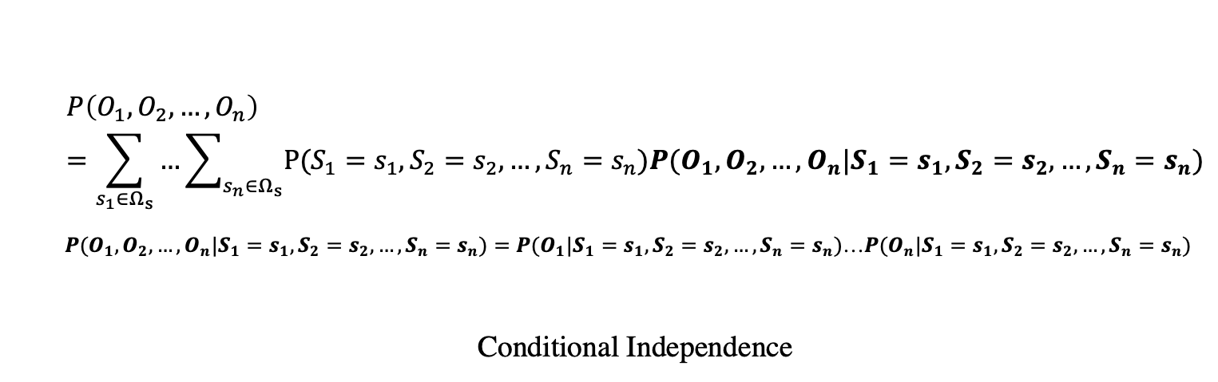
$$P\left(O_{1},O_{2},…,O_{n}\right)=\sum_{s_{1}∈Ω_{s}}{…\sum_{s_{n}∈Ω_{s}}{P(S_{1}=s_{1}, S_{2}=s_{2},…,S_{n}=s_{n})P(O_{1},O_{2},…,O_{n}|S_{1}=s_{1}, S_{2}=s_{2},…,S_{n}=s_{n})}}$$
$P(O_{1},O_{2},…,O_{n}|S_{1}=s_{1}, S_{2}=s_{2},…,S_{n}=s_{n})=P(O_{1}|S_{1}=s_{1}, S_{2}=s_{2},…,S_{n}=s_{n})$…$P(O_{n}|S_{1}=s_{1}, S_{2}=s_{2},…,S_{n}=s_{n})$
Conditional Independence

Slide 15
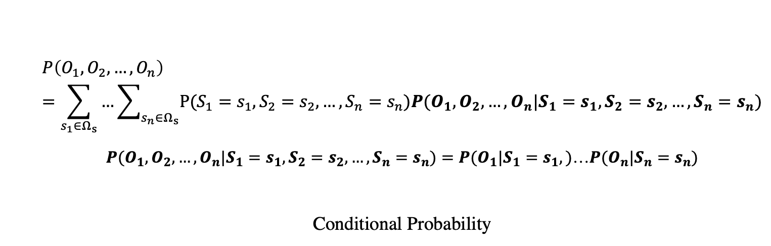
$$P\left(O_{1},O_{2},…,O_{n}\right)=\sum_{s_{1}∈Ω_{s}}{…\sum_{s_{n}∈Ω_{s}}{P(S_{1}=s_{1}, S_{2}=s_{2},…,S_{n}=s_{n})P(O_{1},O_{2},…,O_{n}|S_{1}=s_{1}, S_{2}=s_{2},…,S_{n}=s_{n})}}$$
$P(O_{1},O_{2},…,O_{n}|S_{1}=s_{1}, S_{2}=s_{2},…,S_{n}=s_{n})=P(O_{1}|S_{1}=s_{1},)$…$P(O_{n}|S_{n}=s_{n})$
Conditional Probability

Slide 16
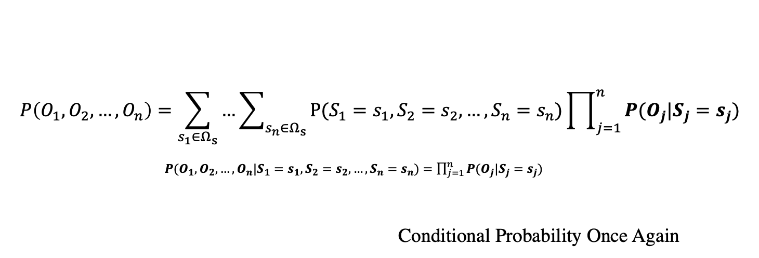
$$P\left(O_{1},O_{2},…,O_{n}\right)=\sum_{s_{1}∈Ω_{s}}{…\sum_{s_{n}∈Ω_{s}}{P(S_{1}=s_{1}, S_{2}=s_{2},…,S_{n}=s_{n})\prod_{j=1}^{n}{P(O_{j}|S_{j}=s_{j})}}}$$
$P(O_{1},O_{2},…,O_{n}|S_{1}=s_{1}, S_{2}=s_{2},…,S_{n}=s_{n})=\prod_{j=1}^{n}{P(O_{j}|S_{j}=s_{j})}$
Conditional Probability Once Again

Slide 17
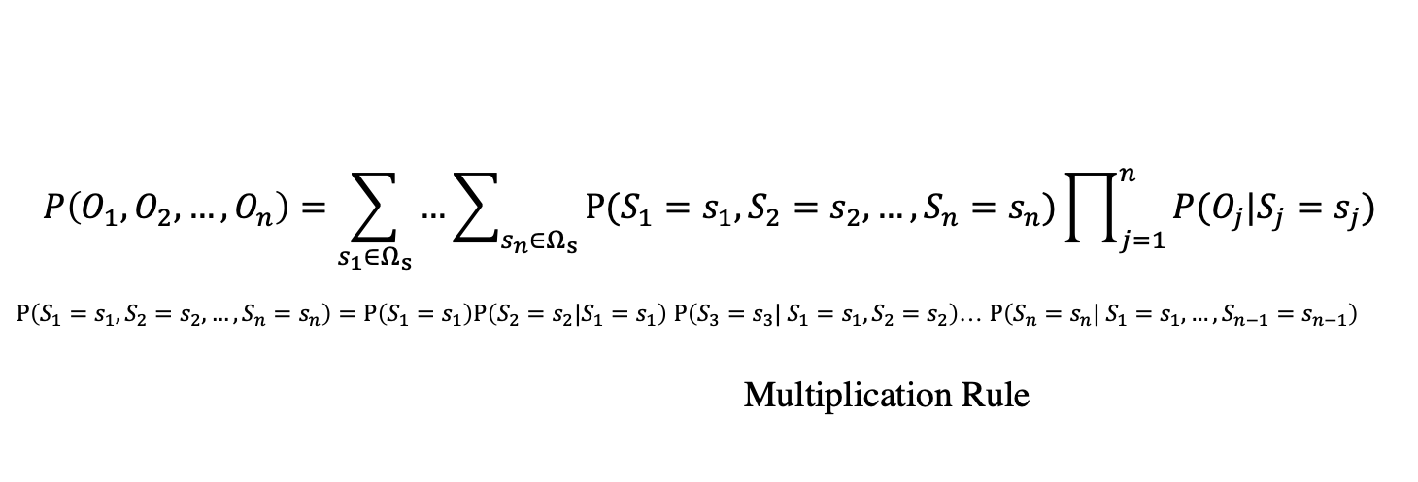
$$P\left(O_{1},O_{2},…,O_{n}\right)=\sum_{s_{1}∈Ω_{s}}{…\sum_{s_{n}∈Ω_{s}}{P(S_{1}=s_{1}, S_{2}=s_{2},…,S_{n}=s_{n})\prod_{j=1}^{n}{P(O_{j}|S_{j}=s_{j})}}}$$
$P\left(S_{1}=s_{1}, S_{2}=s_{2},…,S_{n}=s_{n}\right)=P\left(S_{1}=s_{1}\right)P\left(S_{2}=s_{2}|S_{1}=s_{1}\right)$ $P\left(S_{3}=s_{3}| S_{1}=s_{1},S_{2}=s_{2}\right)$… $P\left(S_{n}=s_{n}| S_{1}=s_{1},…,S_{n−1}=s_{n−1}\right)$
Multiplication Rule

Slide 18
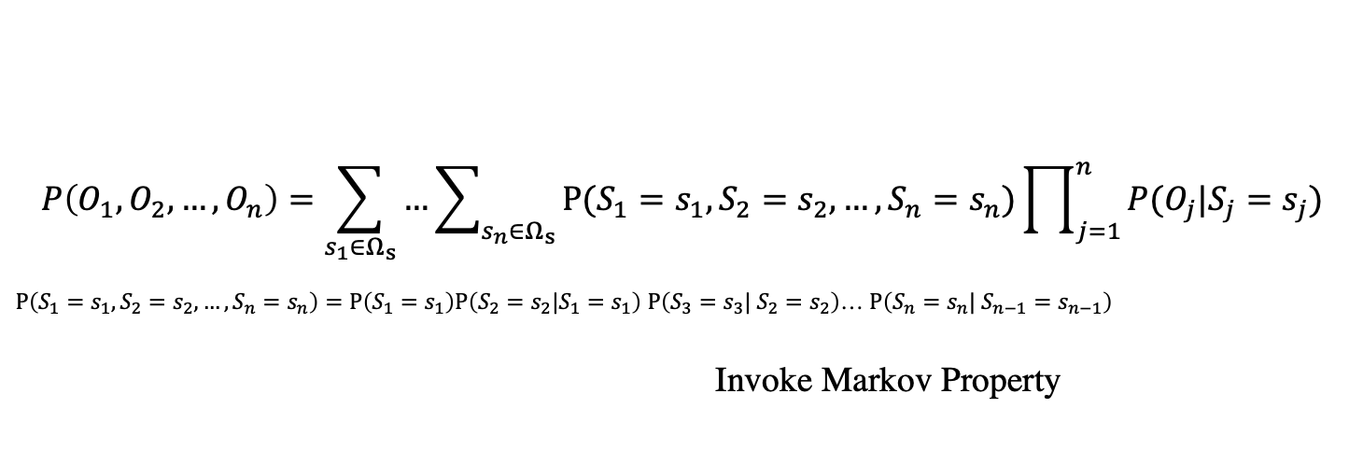
$$P\left(O_{1},O_{2},…,O_{n}\right)=\sum_{s_{1}∈Ω_{s}}{…\sum_{s_{n}∈Ω_{s}}{P(S_{1}=s_{1}, S_{2}=s_{2},…,S_{n}=s_{n})\prod_{j=1}^{n}{P(O_{j}|S_{j}=s_{j})}}}$$
$P\left(S_{1}=s_{1}, S_{2}=s_{2},…,S_{n}=s_{n}\right)=P\left(S_{1}=s_{1}\right)P\left(S_{2}=s_{2}|S_{1}=s_{1}\right)$ $P\left(S_{3}=s_{3}| S_{2}=s_{2}\right)$… $P\left(S_{n}=s_{n}| S_{n−1}=s_{n−1}\right)$
Invoke Markov Property

Slide 19
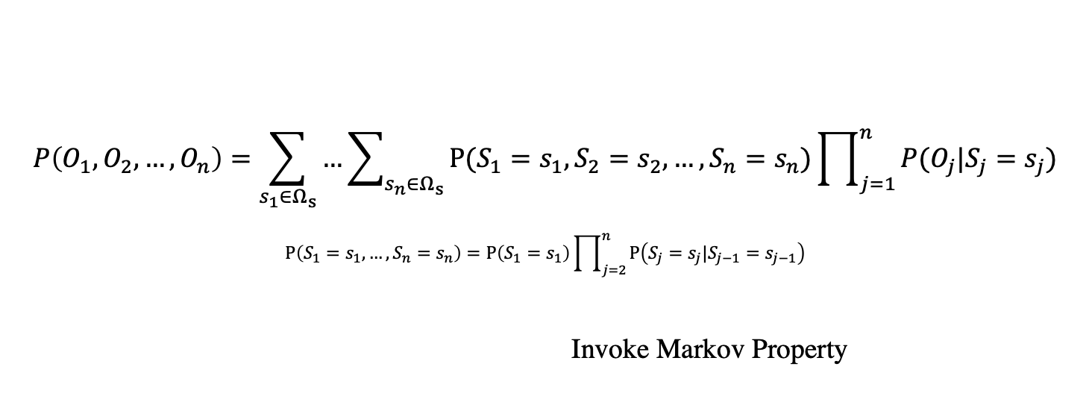
$$P\left(O_{1},O_{2},…,O_{n}\right)=\sum_{s_{1}∈Ω_{s}}{…\sum_{s_{n}∈Ω_{s}}{P(S_{1}=s_{1}, S_{2}=s_{2},…,S_{n}=s_{n})\prod_{j=1}^{n}{P(O_{j}|S_{j}=s_{j})}}}$$
$$P\left(S_{1}=s_{1},…,S_{n}=s_{n}\right)=P\left(S_{1}=s_{1}\right)\prod_{j=2}^{n}{P\left(S_{j}=s_{j}|S_{j−1}=s_{j−1}\right)}$$
Invoke Markov Property

Slide 20
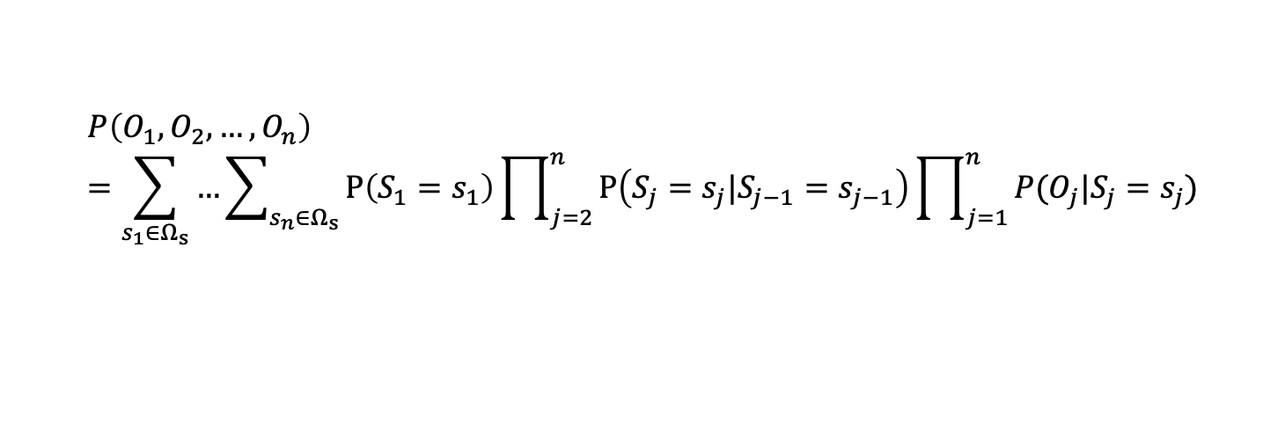
$$P\left(O_{1},O_{2},…,O_{n}\right)=\sum_{s_{1}∈Ω_{s}}{…\sum_{s_{n}∈Ω_{s}}{P\left(S_{1}=s_{1}\right)\prod_{j=2}^{n}{P\left(S_{j}=s_{j}|S_{j−1}=s_{j−1}\right)}\prod_{j=1}^{n}{P(O_{j}|S_{j}=s_{j})}}}$$

Slide 21
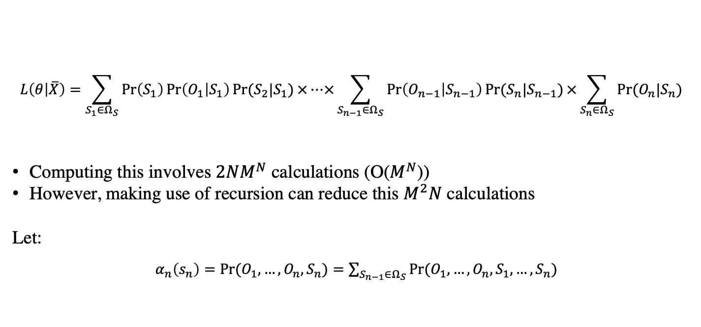
The Forward Algorithm
$$L\left(θ | \overline{X}\right)=\sum_{S_{1}∈Ω_{S}}{\operatorname{Pr}\left(S_{1}\right)\operatorname{Pr}\left(O_{1} | S_{1}\right)\operatorname{Pr}{(S_{2}|S_{1})}×…×\sum_{S_{n−1}∈Ω_{S}}{\operatorname{Pr}\left(O_{n−1} | S_{n−1}\right)\operatorname{Pr}{(S_{n}|S_{n−1})}×\sum_{S_{n}∈Ω_{S}}{\operatorname{Pr}{(O_{n}|S_{n}) }}}}$$
Computing this involves ${2NM}^{N}$ calculations (O($M^{N}$))
However, making use of recursion can reduce this $M^{2}N$ calculations
Let:
$α_{n}\left(s_{n}\right)=\operatorname{Pr}{(O_{1},…,O_{n},S_{n})}=\sum_{S_{n−1}∈Ω_{S}}{\operatorname{Pr}{(O_{1},…,O_{n},{S_{1},…,S}_{n})}}$

Slide 22
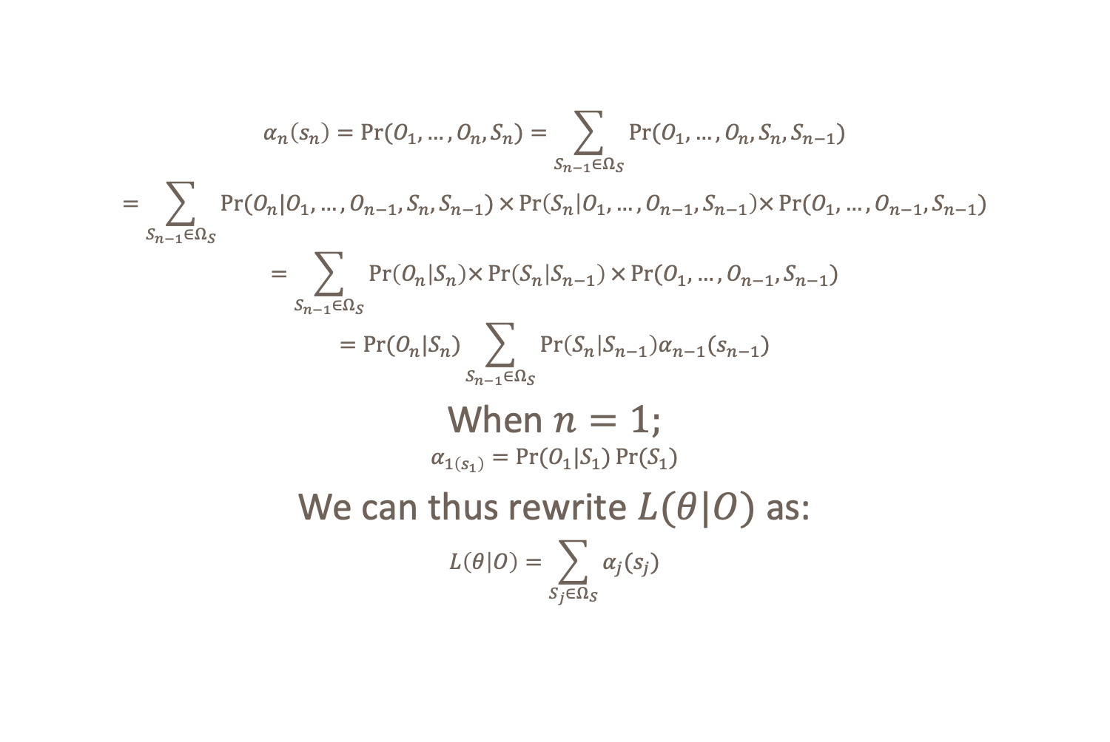
$$α_{n}\left(s_{n}\right)=\operatorname{Pr}{(O_{1},…,O_{n},S_{n})}=\sum_{S_{n−1}∈Ω_{S}}{\operatorname{Pr}{(O_{1},…,O_{n},S_{n},S_{n−1})}}$$
$$=\sum_{S_{n−1}∈Ω_{S}}{\operatorname{Pr}{(O_{n}|O_{1},…,O_{n−1},S_{n},S_{n−1})}}×\operatorname{Pr}\left(S_{n} | O_{1},…,O_{n−1},S_{n−1}\right)×\operatorname{Pr}{(O_{1},…,O_{n−1},S_{n−1})}$$
$$=\sum_{S_{n−1}∈Ω_{S}}{\operatorname{Pr}\left(O_{n} | S_{n}\right)×\operatorname{Pr}\left(S_{n} | S_{n−1}\right)×\operatorname{Pr}{(O_{1},…,O_{n−1}, S_{n−1})}}$$
$$=\operatorname{Pr}{(O_{n}|S_{n})}\sum_{S_{n−1}∈Ω_{S}}{\operatorname{Pr}\left(S_{n} | S_{n−1}\right)α_{n−1}(s_{n−1})}$$
When $n=1;$
$$α_{1\left(s_{1}\right)}=\operatorname{Pr}{(O_{1}|S_{1})}\operatorname{Pr}{(S_{1})}$$
We can thus rewrite $L(θ|O)$ as:
$$L\left(θ | O\right)=\sum_{S_{j}∈Ω_{S}}{α_{j}(s_{j})}$$

Slide 23
Connect these 2 plus vertibi to describe the process

